Slide 1
MSDS670_X40_Data Visualization
Regis University
Week 4 Mid-Term Project:
Ilse Severance

Slide 2
Introduction
During this analysis, we aim to understand how the dataset’s bias toward male customers may mislead overall revenue comparisons. Therefore, before making strategic decisions, we need to determine whether this gender imbalance affects spending behavior, or if it is simply a matter of customer volume.

Slide 3
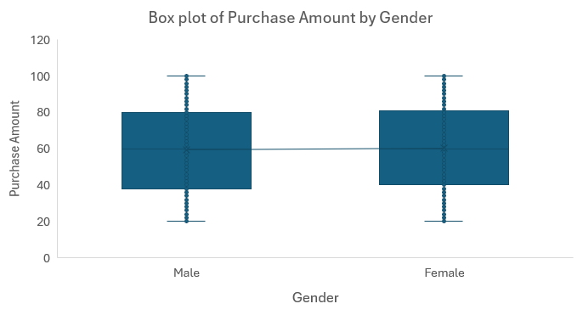
Distribution of Purchase Amount by Gender
The average purchase amount shows minimal differences between genders.
Per-transaction spending remains consistent regardless of gender.
Gender differences affect purchase volume, not the amount spent per transaction.

Slide 4
Purchase Frequency and Average Amount by Gender
Overall spending differences are influenced more by purchase frequency than by gender itself.
Males tend to spend slightly more due to making purchases more frequently.
Females generally spend more per transaction but shop less often.

Slide 5
Average Purchase Amount by Category and Gender
Purchase amount differences between genders are minimal across most categories.
The only noticeable variation appears in the Outwear category.
However, the small difference of ~ 2 dollars indicates no meaningful gender-based spending gap.

Slide 6
Average of Purchase Amount by Discount Applied and Gender
Female customers are less likely to purchase items with discounts.
Male customers are more likely to use discounts when shopping.
The lower average purchase amount among males suggests discounts influence spending more than gender differences.

Slide 7
Conclusions
The dataset is heavily male influenced, but this does not appear to have an impact in spending behavior. Average purchase amounts and spending distributions are similar across board.
Differences in total revenue are primary due to customer volume, not spending behavior with the primary influence on spending differences being discount usage.
The analysis suggests that marketing and discount strategies should focus on attracting a larger female customer base to increase revenue

